Slide 1

Lesson Plan Starter Kit
NABIRA BINTI MANSOR
PRACTICUM & INDUSTRIAL TRAINING COORDINATOR, UPTM
MASTER OF EDUCATION (TESL), UKM

Slide 2
Today, you are going to know about..
1
2
3
4
Introduction to CEFR
The CEFR-Aligned Documents in the Classroom
Writing and Planning a Lesson
Q & A

Slide 3
1
Introduction to CEFR

Slide 4

What is CEFR?
Aspirational Targets 2015-2025

Slide 5
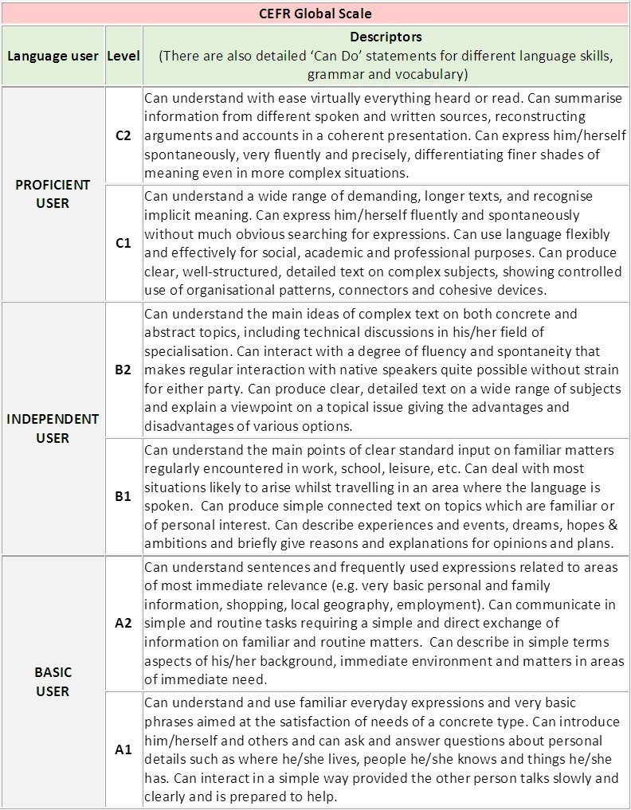
CEFR Global Scale

Slide 6
2
Do your homework
Jupiter is a gas giant and the biggest planet in the Solar System
The CEFR-Aligned Documents in the Classroom
Bring your meal
Despite being red, Mars is actually a cold place. It's full of iron oxide dust
It’s the closest planet to the Sun and the smallest one in the Solar System

Slide 7

As a teacher, I should know these!
1
2
CEFR
DSKP (Syllabus)
Common European Framework of Reference for Language
Dokumen Standard Kurikulum dan Pentaksiran (Grammar component incorporated in the FOUR (4) skills)
3
4
SoW
LP
Scheme of Work. Overview of Content and Learning Standards , lesson content and materials for their lessons
Lesson plans. Different schools different format

Slide 8
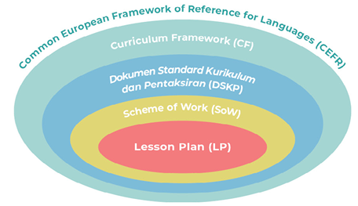
How do the documents fit into day to day teaching?

Slide 9

Curriculum Content Standard and Learning Standards
1
What are Content Standards?
Area of learning / skills
2
What are Learning Standards?
Detailed, observable skills
Within Content Standard area
Target for end of each school year
3
How are they organised?
By skill + Language Arts (LA)
CS + Focus + LS Years 1-6 / Form 1 – Form 5
Numbered

Slide 10
How the CS and LS are numbered?
1 = | Listening skill
2 = | Speaking skill
3 = | Reading skill
4 = | Writing skill
5 =
Language Arts

Slide 11
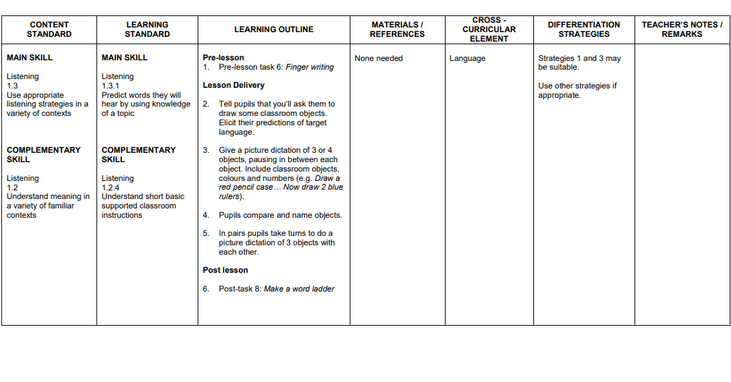
Examples..

Slide 12
3
Do your homework
Bring your book
Writing and Planning
a Lesson
Jupiter is a gas giant and the biggest planet in the Solar System
Neptune is the farthest planet from the Sun. It's also the fourth-largest

Slide 13
What are the stages?
BEFORE | WHILE | AFTER
Refer to relevant documents | Identify the Learning Standards (LS)
Refer to relevant teaching and learning materials | Write the Learning Objectives (LO) | Review teaching and learning
 | Plan the learning and prepare the materials

Slide 14
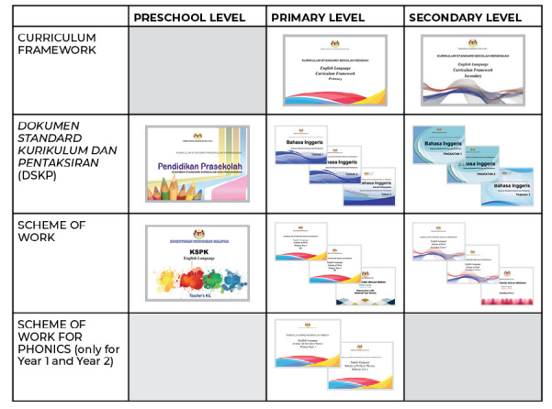
BEFORE : I can’t teach if I don’t have these..

Slide 15

BEFORE : These are the compulsory teaching and learning materials..

Slide 16
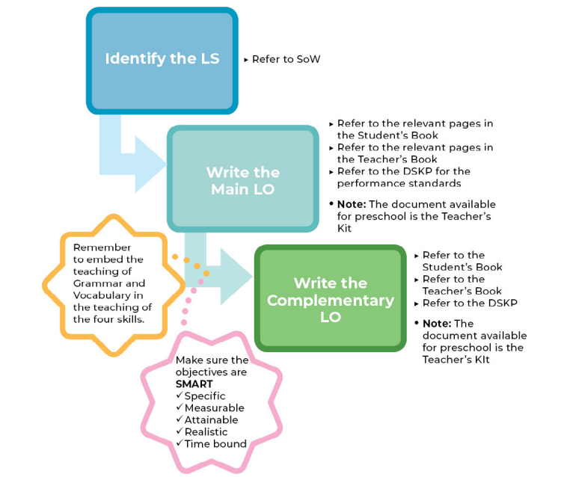
WHILE : I need to identify the LS and write the LO..

Slide 17
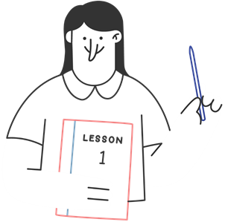

The LP MUST adhere to these..
ONE (1) or TWO objectives are adequate as long as measure the CS & LS
The LO must SMART . Action verb must be measurable. E.g. ‘know’
LO and Success Criteria must be written on the whiteboard BEFORE the lesson begins and go through the LO & SC before the lesson.
It is based on ‘can do’ statements. By the end of the lesson, pupils / students WILL be able to :

Slide 18
The LP MUST adhere to these..
Use imperative sentences in Simple Present Tense.
In class activity section - subject of the sentence starts with Students/Pupils. Eg: Students answer Exercise 1. Students fill in the blanks. Students conduct a role play.
In lesson delivery - subject of the sentence starts with Teacher. Eg: Teacher reads the short story. Teacher explains the difficult words in the short story.
Non significant activities - no need to mention in the Lesson Plan. Eg: Teacher asks students how they are. Teacher asks students whether they have taken their breakfast etc2.. (non significant - not contributing to the lesson) but can be used verbally to build rapport with students.

Slide 19
Examples :
LEARNING OBJECTIVES :
By the end of the lesson, pupils will be able to :
Write sentences by using idioms correctly.
SUCCESS CRITERIA :
Pupils/ Students can :
Match all idioms at least 3/5 questions.
Write 5 sentences by using idioms to express emotions correctly.

Slide 20
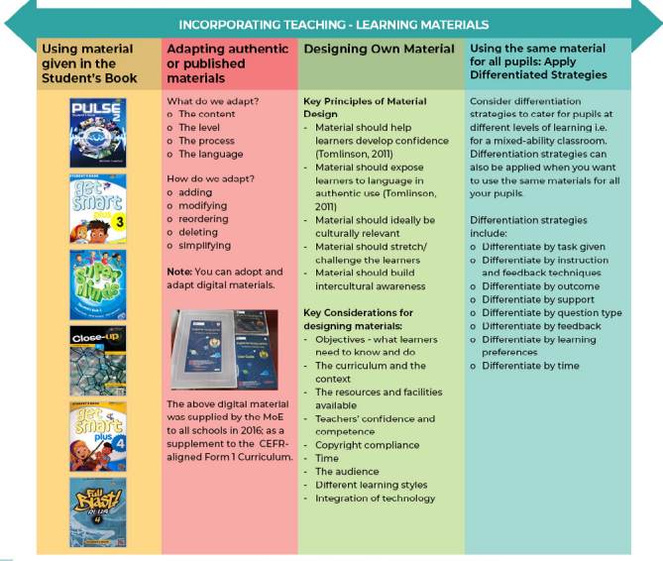
WHILE : I can prepare the materials based on these..

Slide 21
Differentiation Strategies
Type of differentiation | Strategy explanation
1. type & amount of support | An approach to lesson planning in which you plan extension tasks for the more able pupils and support mechanisms for the less able.
2. time | Adjusting pace and timing for activities according to individual needs; making time limits in lessons concrete for all pupils.
3. outcome (or target) | Planning activities so that every pupil says or writes something, so that they all feel successful. Setting SMART targets is helpful and encourages pupils to aim for a specific goal.
4. learning preferences and needs | Creating a classroom culture of cooperation and support, in which pupils of different ability and proficiency work in pairs and groups to allow them to benefit from different dynamics and preferences.
5. feedback | Planning and giving suggestions for improvement according to pupils’ ability to act upon it, thus making suggestions achievable.
6. instruction | Using different classroom management techniques and resources (technology or paper-based) that support individual learning needs and makes learning accessible to all proficiency levels.
7. types of questions | Using closed and open questions with pupils based on their language proficiency levels and how much the teacher wants to stretch pupils’ skills.

Slide 22
WHILE : Next, I plan the learning..
Pre - Lesson
(Set Induction)
Lesson Development (Lesson Delivery)
Post – Lesson (Closure)

Slide 23
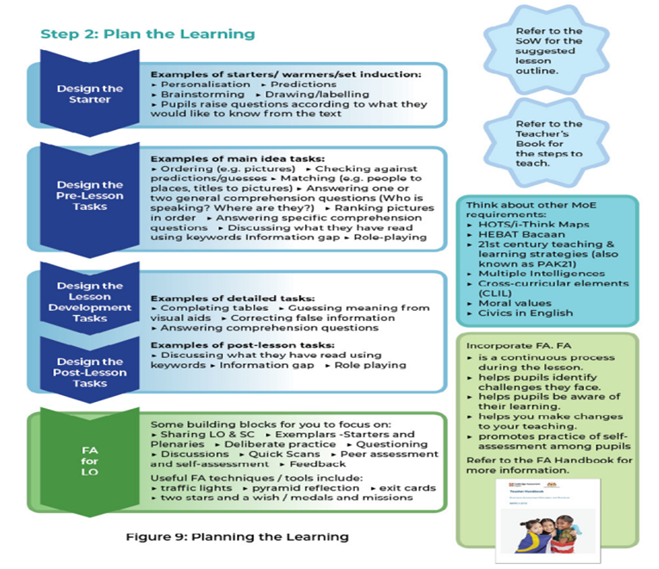


Slide 24




Do’s and Don’ts
Pre - lesson | Warm-up activity – INTERESTING , RELATE WITH PUPILS BACKGROUND DO NOT tell the LO abruptly
Lesson Development | TEACHING PART must be shown The activities can be TWO (2) along with ONE (1) Formative Assessments (FA) * Depends on class duration
Post-Lesson | Reviewing the LO Moral Values (Optional) Get the pupils feedback

Slide 25

AFTER : I reflect the teaching and learning...
Have I achieved the learning standards?
Have I reached the learning objectives?
Was the allocation of time for the task appropriate?
Did I use the materials that I had planned to use?
Did I manage to involve all pupils in the activities?
Was my pre-lesson/post -lesson task suitable or effective?
Were the differentiation strategies appropriate?
Did I carry out any formative assessment?
What knowledge or skill did my pupils have problem understanding?
What values did I manage to impart to my pupils?
What do I need to revise and consolidate?
Is remedial or enrichment work needed?

Slide 26
Examples :
E.g. REFLECTION :
30/32 pupils were able to achieve learning objectives.
Students could use suitable part of speech learnt most corr
This lesson was not complete. The teacher could not give any notes yet as she used a lot of time reading important parts in the short story to the students and making them understanding the main characters’ problems. This will be continued on Tuesday.

Slide 27

FAQ
Why is the English language curriculum changing?
To align our curriculum with the international standards.
We are setting new targets to achieve the national aspirations
Why does the new KSSM/KSSR curriculum adopt the CEFR?
CEFR can help to differentiate different levels of proficiency
It is widely used and recognized
Check the student’s progress
Where can you find the staged targets for learning English?
From the curriculum framework

Slide 28
FAQ
4. What kind of Malaysian pupils are we preparing for the future?
5Cs
Communicative
Creative
Collaborative
Responsible
Intercultural awareness
5. What are the Learning Standards?
LS- More detailed and observable skills within the area defined by each Content Standard.

Slide 29
FAQ
6. Why can’t we use the exact wording of the CEFR descriptors in the
curriculum?
Mixed abilities pupils
Needs to be specific

Slide 30


THE END
ANY QUESTION?

